Slide 1
Standardized Infection Ratio

Slide 2
Topics
Standardization
Standardized infection ratio (SIR)
Standardized utilization ratio (SUR)
Examples
Example of SIR
SSI SIR
MOH CLABSI SIR/SUR
New SSI SIR

Slide 3
Standardization
Standardization refers to methods of adjustment based on weighted averages
 | Direct Standardization | Indirect Standardization
Requirement | Specific rates of the study population | Specific rates of the standard population
Use | Uncommonly used | Commonly used
Example | Calculating age and sex adjusted rates of infection in a study (adjusted to 2010 US population) | Standardized mortality ratio of a population compare with overall US mortality rates
Notes:
Crude measure: is an overall total population measure that does not take explicit account of the composition of the population.
Direct Standardization
Direct standardization is the case were the age specific mortality rates from the index, which is mostly the smaller population in which we are interested, is multiplied with the age structure of a standard.
You can compare the standardized rate with another standardized rate that has been standardized in the same way.
The two rates can be compared directly or the CMF, the ratio of the two rates, can be used.
What are the requirements of direct age adjustment method?
Age–specific mortality rates for the 2 study populations being compared
A standard population which is any population (a real or hypothetical) having a known age composition, selected to be the basis of the comparison
Indirect Standardization
Indirect standardization is the case were the age specific mortality rates from the standard are multiplied with the age structure of the index.
The end result is mostly an expected number of death for the index population which can be compared with the observed number of death using the SMR.
Age specific death rates for the index are not required to do indirect standardization.
What are the requirements of indirect age adjustment method?
Age–specific mortality rates for a standard population
The total number of events (deaths) and age composition of the 2 study populations
SMR
SMR basically compares the mortality observed in the index-population with the mortality that could be expected, if the index-population had an age specific mortality pattern, which is comparable with the age specific mortality of the standard population.
Exact confidence intervals are given when the number of cases is relatively low and approximations are given when the number of cases is larger.
Poisson based confidence intervals are given considering error free expectations, this would be the case if the standard would be a hypothetical mortality schedule.

Slide 4
Standardized infection ratio Standardized utilization ratio

Slide 5
Standardized infection ratio
The standardized infection ratio (SIR) is a summary measure used to track HAIs at a national, state, or local level over time.
SIR provides improved risk adjustment and replace risk-stratified HAI rates.
Observed HAI events
HAI SIR=
Expected HAI events
Notes:
Crude measure: is an overall total population measure that does not take explicit account of the composition of the population.
Direct Standardization
Direct standardization is the case were the age specific mortality rates from the index, which is mostly the smaller population in which we are interested, is multiplied with the age structure of a standard.
You can compare the standardized rate with another standardized rate that has been standardized in the same way.
The two rates can be compared directly or the CMF, the ratio of the two rates, can be used.
What are the requirements of direct age adjustment method?
Age–specific mortality rates for the 2 study populations being compared
A standard population which is any population (a real or hypothetical) having a known age composition, selected to be the basis of the comparison
Indirect Standardization
Indirect standardization is the case were the age specific mortality rates from the standard are multiplied with the age structure of the index.
The end result is mostly an expected number of death for the index population which can be compared with the observed number of death using the SMR.
Age specific death rates for the index are not required to do indirect standardization.
What are the requirements of indirect age adjustment method?
Age–specific mortality rates for a standard population
The total number of events (deaths) and age composition of the 2 study populations
SMR
SMR basically compares the mortality observed in the index-population with the mortality that could be expected, if the index-population had an age specific mortality pattern, which is comparable with the age specific mortality of the standard population.
Exact confidence intervals are given when the number of cases is relatively low and approximations are given when the number of cases is larger.
Poisson based confidence intervals are given considering error free expectations, this would be the case if the standard would be a hypothetical mortality schedule.

Slide 6
Standardized Utilization Ratio
The standardized utilization ratio (SUR) is a summary measure used to track DUR at a national, state, or local level over time.
SUR provides improved risk adjustment and replace risk-stratified DUR rates.
Observed device days
HAI SUR=
Expected device days
Notes:
Crude measure: is an overall total population measure that does not take explicit account of the composition of the population.
Direct Standardization
Direct standardization is the case were the age specific mortality rates from the index, which is mostly the smaller population in which we are interested, is multiplied with the age structure of a standard.
You can compare the standardized rate with another standardized rate that has been standardized in the same way.
The two rates can be compared directly or the CMF, the ratio of the two rates, can be used.
What are the requirements of direct age adjustment method?
Age–specific mortality rates for the 2 study populations being compared
A standard population which is any population (a real or hypothetical) having a known age composition, selected to be the basis of the comparison
Indirect Standardization
Indirect standardization is the case were the age specific mortality rates from the standard are multiplied with the age structure of the index.
The end result is mostly an expected number of death for the index population which can be compared with the observed number of death using the SMR.
Age specific death rates for the index are not required to do indirect standardization.
What are the requirements of indirect age adjustment method?
Age–specific mortality rates for a standard population
The total number of events (deaths) and age composition of the 2 study populations
SMR
SMR basically compares the mortality observed in the index-population with the mortality that could be expected, if the index-population had an age specific mortality pattern, which is comparable with the age specific mortality of the standard population.
Exact confidence intervals are given when the number of cases is relatively low and approximations are given when the number of cases is larger.
Poisson based confidence intervals are given considering error free expectations, this would be the case if the standard would be a hypothetical mortality schedule.

Slide 7
Standardized infection ratio
Notes:
Crude measure: is an overall total population measure that does not take explicit account of the composition of the population.
Direct Standardization
Direct standardization is the case were the age specific mortality rates from the index, which is mostly the smaller population in which we are interested, is multiplied with the age structure of a standard.
You can compare the standardized rate with another standardized rate that has been standardized in the same way.
The two rates can be compared directly or the CMF, the ratio of the two rates, can be used.
What are the requirements of direct age adjustment method?
Age–specific mortality rates for the 2 study populations being compared
A standard population which is any population (a real or hypothetical) having a known age composition, selected to be the basis of the comparison
Indirect Standardization
Indirect standardization is the case were the age specific mortality rates from the standard are multiplied with the age structure of the index.
The end result is mostly an expected number of death for the index population which can be compared with the observed number of death using the SMR.
Age specific death rates for the index are not required to do indirect standardization.
What are the requirements of indirect age adjustment method?
Age–specific mortality rates for a standard population
The total number of events (deaths) and age composition of the 2 study populations
SMR
SMR basically compares the mortality observed in the index-population with the mortality that could be expected, if the index-population had an age specific mortality pattern, which is comparable with the age specific mortality of the standard population.
Exact confidence intervals are given when the number of cases is relatively low and approximations are given when the number of cases is larger.
Poisson based confidence intervals are given considering error free expectations, this would be the case if the standard would be a hypothetical mortality schedule.

Slide 8
Advantages of SIR
Single summary metric
One number that can be used to make comparisons
Risk-adjusted
Adjusts for factors known to be associated with differences in HAI rates
Scalable
Can be calculated at national, regional, facility-wide, location-specific, by surgeon for SSIs, etc.
Easy understood
An easier measure to discuss among internal and external stakeholders
Notes:
Crude measure: is an overall total population measure that does not take explicit account of the composition of the population.
Direct Standardization
Direct standardization is the case were the age specific mortality rates from the index, which is mostly the smaller population in which we are interested, is multiplied with the age structure of a standard.
You can compare the standardized rate with another standardized rate that has been standardized in the same way.
The two rates can be compared directly or the CMF, the ratio of the two rates, can be used.
What are the requirements of direct age adjustment method?
Age–specific mortality rates for the 2 study populations being compared
A standard population which is any population (a real or hypothetical) having a known age composition, selected to be the basis of the comparison
Indirect Standardization
Indirect standardization is the case were the age specific mortality rates from the standard are multiplied with the age structure of the index.
The end result is mostly an expected number of death for the index population which can be compared with the observed number of death using the SMR.
Age specific death rates for the index are not required to do indirect standardization.
What are the requirements of indirect age adjustment method?
Age–specific mortality rates for a standard population
The total number of events (deaths) and age composition of the 2 study populations
SMR
SMR basically compares the mortality observed in the index-population with the mortality that could be expected, if the index-population had an age specific mortality pattern, which is comparable with the age specific mortality of the standard population.
Exact confidence intervals are given when the number of cases is relatively low and approximations are given when the number of cases is larger.
Poisson based confidence intervals are given considering error free expectations, this would be the case if the standard would be a hypothetical mortality schedule.

Slide 9
SIR-Calculation and interpretation notes
The SIRs calculated by NHSN use 2006-2008 as the baseline period, & therefore, SIRs are calculated for 2009 and forward.
To allow for more precise comparisons, SIRs are calculated only if the number of expected HAIs is ≥1
When the expected HAI <1, this indicates that the denominator (e.g. number of device days or procedures ) in the facility or location is too low to calculate a precise SIR and comparative statistics.
Notes:
Crude measure: is an overall total population measure that does not take explicit account of the composition of the population.
Direct Standardization
Direct standardization is the case were the age specific mortality rates from the index, which is mostly the smaller population in which we are interested, is multiplied with the age structure of a standard.
You can compare the standardized rate with another standardized rate that has been standardized in the same way.
The two rates can be compared directly or the CMF, the ratio of the two rates, can be used.
What are the requirements of direct age adjustment method?
Age–specific mortality rates for the 2 study populations being compared
A standard population which is any population (a real or hypothetical) having a known age composition, selected to be the basis of the comparison
Indirect Standardization
Indirect standardization is the case were the age specific mortality rates from the standard are multiplied with the age structure of the index.
The end result is mostly an expected number of death for the index population which can be compared with the observed number of death using the SMR.
Age specific death rates for the index are not required to do indirect standardization.
What are the requirements of indirect age adjustment method?
Age–specific mortality rates for a standard population
The total number of events (deaths) and age composition of the 2 study populations
SMR
SMR basically compares the mortality observed in the index-population with the mortality that could be expected, if the index-population had an age specific mortality pattern, which is comparable with the age specific mortality of the standard population.
Exact confidence intervals are given when the number of cases is relatively low and approximations are given when the number of cases is larger.
Poisson based confidence intervals are given considering error free expectations, this would be the case if the standard would be a hypothetical mortality schedule.

Slide 10
SIR-Calculation and interpretation notes
When this is the case, you may wish to group your SIRs by a longer time period, such as year
Remove from your data any rates that had no corresponding published NHSN rates
Interpretation:
SIR<1 means that after adjusting for differences, fewer HAIs were observed than predicted
SIR>1 means that after adjusting for differences, more HAIs were observed than predicted
SIR=1 means that after adjusting for differences, Same HAIs were observed as predicted
Notes:
Crude measure: is an overall total population measure that does not take explicit account of the composition of the population.
Direct Standardization
Direct standardization is the case were the age specific mortality rates from the index, which is mostly the smaller population in which we are interested, is multiplied with the age structure of a standard.
You can compare the standardized rate with another standardized rate that has been standardized in the same way.
The two rates can be compared directly or the CMF, the ratio of the two rates, can be used.
What are the requirements of direct age adjustment method?
Age–specific mortality rates for the 2 study populations being compared
A standard population which is any population (a real or hypothetical) having a known age composition, selected to be the basis of the comparison
Indirect Standardization
Indirect standardization is the case were the age specific mortality rates from the standard are multiplied with the age structure of the index.
The end result is mostly an expected number of death for the index population which can be compared with the observed number of death using the SMR.
Age specific death rates for the index are not required to do indirect standardization.
What are the requirements of indirect age adjustment method?
Age–specific mortality rates for a standard population
The total number of events (deaths) and age composition of the 2 study populations
SMR
SMR basically compares the mortality observed in the index-population with the mortality that could be expected, if the index-population had an age specific mortality pattern, which is comparable with the age specific mortality of the standard population.
Exact confidence intervals are given when the number of cases is relatively low and approximations are given when the number of cases is larger.
Poisson based confidence intervals are given considering error free expectations, this would be the case if the standard would be a hypothetical mortality schedule.

Slide 11
CLABSI SIR

Slide 12
CLABSI SIR-Calculation
Type of ICU | CALBSI events | CL days | Hospital rates | NHSN rates | Expected CLABSI
Medical cardiac | 2 | 380
Medical | 1 | 257
Medical surgical | 3 | 627
Neurosurgical | 2 | 712
Total | 8 | 1976
Notes:
Crude measure: is an overall total population measure that does not take explicit account of the composition of the population.
Direct Standardization
Direct standardization is the case were the age specific mortality rates from the index, which is mostly the smaller population in which we are interested, is multiplied with the age structure of a standard.
You can compare the standardized rate with another standardized rate that has been standardized in the same way.
The two rates can be compared directly or the CMF, the ratio of the two rates, can be used.
What are the requirements of direct age adjustment method?
Age–specific mortality rates for the 2 study populations being compared
A standard population which is any population (a real or hypothetical) having a known age composition, selected to be the basis of the comparison
Indirect Standardization
Indirect standardization is the case were the age specific mortality rates from the standard are multiplied with the age structure of the index.
The end result is mostly an expected number of death for the index population which can be compared with the observed number of death using the SMR.
Age specific death rates for the index are not required to do indirect standardization.
What are the requirements of indirect age adjustment method?
Age–specific mortality rates for a standard population
The total number of events (deaths) and age composition of the 2 study populations
SMR
SMR basically compares the mortality observed in the index-population with the mortality that could be expected, if the index-population had an age specific mortality pattern, which is comparable with the age specific mortality of the standard population.
Exact confidence intervals are given when the number of cases is relatively low and approximations are given when the number of cases is larger.
Poisson based confidence intervals are given considering error free expectations, this would be the case if the standard would be a hypothetical mortality schedule.

Slide 13
CLABSI SIR-Calculation
Type of ICU | CALBSI events | CL days | Hospital rates | NHSN rates | Expected CLABSI
Medical cardiac | 2 | 380 | 5.26
Medical | 1 | 257 | 3.89
Medical surgical | 3 | 627 | 4.78
Neurosurgical | 2 | 712 | 2.81
Total | 8 | 1976 | 4.05
Hospital CLABSI rate = CLABSI events x 1000 = 2 x1000 = 5.26
CL days 380
Notes:
Crude measure: is an overall total population measure that does not take explicit account of the composition of the population.
Direct Standardization
Direct standardization is the case were the age specific mortality rates from the index, which is mostly the smaller population in which we are interested, is multiplied with the age structure of a standard.
You can compare the standardized rate with another standardized rate that has been standardized in the same way.
The two rates can be compared directly or the CMF, the ratio of the two rates, can be used.
What are the requirements of direct age adjustment method?
Age–specific mortality rates for the 2 study populations being compared
A standard population which is any population (a real or hypothetical) having a known age composition, selected to be the basis of the comparison
Indirect Standardization
Indirect standardization is the case were the age specific mortality rates from the standard are multiplied with the age structure of the index.
The end result is mostly an expected number of death for the index population which can be compared with the observed number of death using the SMR.
Age specific death rates for the index are not required to do indirect standardization.
What are the requirements of indirect age adjustment method?
Age–specific mortality rates for a standard population
The total number of events (deaths) and age composition of the 2 study populations
SMR
SMR basically compares the mortality observed in the index-population with the mortality that could be expected, if the index-population had an age specific mortality pattern, which is comparable with the age specific mortality of the standard population.
Exact confidence intervals are given when the number of cases is relatively low and approximations are given when the number of cases is larger.
Poisson based confidence intervals are given considering error free expectations, this would be the case if the standard would be a hypothetical mortality schedule.

Slide 14
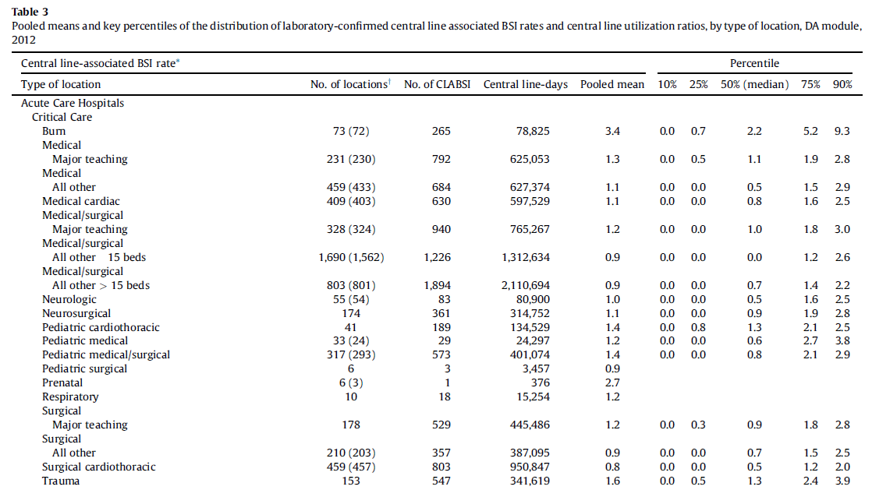
CLABSI SIR-Calculation

Slide 15
CLABSI SIR-Calculation
Type of ICU | CALBSI events | CL days | Hospital rates | NHSN rates | Expected CLABSI
Medical cardiac | 2 | 380 | 5.26 | 2.0
Medical | 1 | 257 | 3.89 | 2.6
Medical surgical | 3 | 627 | 4.78 | 1.5
Neurosurgical | 2 | 712 | 2.81 | 2.5
Total | 8 | 1976 | 4.05
Published NHSN reports
Notes:
Crude measure: is an overall total population measure that does not take explicit account of the composition of the population.
Direct Standardization
Direct standardization is the case were the age specific mortality rates from the index, which is mostly the smaller population in which we are interested, is multiplied with the age structure of a standard.
You can compare the standardized rate with another standardized rate that has been standardized in the same way.
The two rates can be compared directly or the CMF, the ratio of the two rates, can be used.
What are the requirements of direct age adjustment method?
Age–specific mortality rates for the 2 study populations being compared
A standard population which is any population (a real or hypothetical) having a known age composition, selected to be the basis of the comparison
Indirect Standardization
Indirect standardization is the case were the age specific mortality rates from the standard are multiplied with the age structure of the index.
The end result is mostly an expected number of death for the index population which can be compared with the observed number of death using the SMR.
Age specific death rates for the index are not required to do indirect standardization.
What are the requirements of indirect age adjustment method?
Age–specific mortality rates for a standard population
The total number of events (deaths) and age composition of the 2 study populations
SMR
SMR basically compares the mortality observed in the index-population with the mortality that could be expected, if the index-population had an age specific mortality pattern, which is comparable with the age specific mortality of the standard population.
Exact confidence intervals are given when the number of cases is relatively low and approximations are given when the number of cases is larger.
Poisson based confidence intervals are given considering error free expectations, this would be the case if the standard would be a hypothetical mortality schedule.

Slide 16
CLABSI SIR-Calculation
Type of ICU | CALBSI events | CL days | Hospital rates | NHSN rates | Expected CLABSI
Medical cardiac | 2 | 380 | 5.26 | 2.0 | 0.76
Medical | 1 | 257 | 3.89 | 2.6 | 0.67
Medical surgical | 3 | 627 | 4.78 | 1.5 | 0.94
Neurosurgical | 2 | 712 | 2.81 | 2.5 | 1.78
Total | 8 | 1976 | 4.05
Predicted CLABSI (#) = CL days x NHSN CLABSI rate = 380 x 2.0 = 0.76
1000 1000
Notes:
Crude measure: is an overall total population measure that does not take explicit account of the composition of the population.
Direct Standardization
Direct standardization is the case were the age specific mortality rates from the index, which is mostly the smaller population in which we are interested, is multiplied with the age structure of a standard.
You can compare the standardized rate with another standardized rate that has been standardized in the same way.
The two rates can be compared directly or the CMF, the ratio of the two rates, can be used.
What are the requirements of direct age adjustment method?
Age–specific mortality rates for the 2 study populations being compared
A standard population which is any population (a real or hypothetical) having a known age composition, selected to be the basis of the comparison
Indirect Standardization
Indirect standardization is the case were the age specific mortality rates from the standard are multiplied with the age structure of the index.
The end result is mostly an expected number of death for the index population which can be compared with the observed number of death using the SMR.
Age specific death rates for the index are not required to do indirect standardization.
What are the requirements of indirect age adjustment method?
Age–specific mortality rates for a standard population
The total number of events (deaths) and age composition of the 2 study populations
SMR
SMR basically compares the mortality observed in the index-population with the mortality that could be expected, if the index-population had an age specific mortality pattern, which is comparable with the age specific mortality of the standard population.
Exact confidence intervals are given when the number of cases is relatively low and approximations are given when the number of cases is larger.
Poisson based confidence intervals are given considering error free expectations, this would be the case if the standard would be a hypothetical mortality schedule.

Slide 17
CLABSI SIR-Calculation
Type of ICU | CALBSI events | CL days | Hospital rates | NHSN rates | Expected CLABSI
Medical cardiac | 2 | 380 | 5.26 | 2.0 | 0.76
Medical | 1 | 257 | 3.89 | 2.6 | 0.67
Medical surgical | 3 | 627 | 4.78 | 1.5 | 0.94
Neurosurgical | 2 | 712 | 2.81 | 2.5 | 1.78
Total | 8 | 1976 | 4.05 |  | 4.15
Notes:
Crude measure: is an overall total population measure that does not take explicit account of the composition of the population.
Direct Standardization
Direct standardization is the case were the age specific mortality rates from the index, which is mostly the smaller population in which we are interested, is multiplied with the age structure of a standard.
You can compare the standardized rate with another standardized rate that has been standardized in the same way.
The two rates can be compared directly or the CMF, the ratio of the two rates, can be used.
What are the requirements of direct age adjustment method?
Age–specific mortality rates for the 2 study populations being compared
A standard population which is any population (a real or hypothetical) having a known age composition, selected to be the basis of the comparison
Indirect Standardization
Indirect standardization is the case were the age specific mortality rates from the standard are multiplied with the age structure of the index.
The end result is mostly an expected number of death for the index population which can be compared with the observed number of death using the SMR.
Age specific death rates for the index are not required to do indirect standardization.
What are the requirements of indirect age adjustment method?
Age–specific mortality rates for a standard population
The total number of events (deaths) and age composition of the 2 study populations
SMR
SMR basically compares the mortality observed in the index-population with the mortality that could be expected, if the index-population had an age specific mortality pattern, which is comparable with the age specific mortality of the standard population.
Exact confidence intervals are given when the number of cases is relatively low and approximations are given when the number of cases is larger.
Poisson based confidence intervals are given considering error free expectations, this would be the case if the standard would be a hypothetical mortality schedule.

Slide 18
CLABSI SIR-Calculation
Type of ICU | CALBSI events | CL days | Hospital rates | NHSN rates | Expected CLABSI
Medical cardiac | 2 | 380 | 5.26 | 2.0 | 0.76
Medical | 1 | 257 | 3.89 | 2.6 | 0.67
Medical surgical | 3 | 627 | 4.78 | 1.5 | 0.94
Neurosurgical | 2 | 712 | 2.81 | 2.5 | 1.78
Total | 8 | 1976 | 4.05 |  | 4.15
CALBSI SIR = Expected CLABSI = 8 = 1.93
Observed CLABSI 4.15
Notes:
Crude measure: is an overall total population measure that does not take explicit account of the composition of the population.
Direct Standardization
Direct standardization is the case were the age specific mortality rates from the index, which is mostly the smaller population in which we are interested, is multiplied with the age structure of a standard.
You can compare the standardized rate with another standardized rate that has been standardized in the same way.
The two rates can be compared directly or the CMF, the ratio of the two rates, can be used.
What are the requirements of direct age adjustment method?
Age–specific mortality rates for the 2 study populations being compared
A standard population which is any population (a real or hypothetical) having a known age composition, selected to be the basis of the comparison
Indirect Standardization
Indirect standardization is the case were the age specific mortality rates from the standard are multiplied with the age structure of the index.
The end result is mostly an expected number of death for the index population which can be compared with the observed number of death using the SMR.
Age specific death rates for the index are not required to do indirect standardization.
What are the requirements of indirect age adjustment method?
Age–specific mortality rates for a standard population
The total number of events (deaths) and age composition of the 2 study populations
SMR
SMR basically compares the mortality observed in the index-population with the mortality that could be expected, if the index-population had an age specific mortality pattern, which is comparable with the age specific mortality of the standard population.
Exact confidence intervals are given when the number of cases is relatively low and approximations are given when the number of cases is larger.
Poisson based confidence intervals are given considering error free expectations, this would be the case if the standard would be a hypothetical mortality schedule.

Slide 19
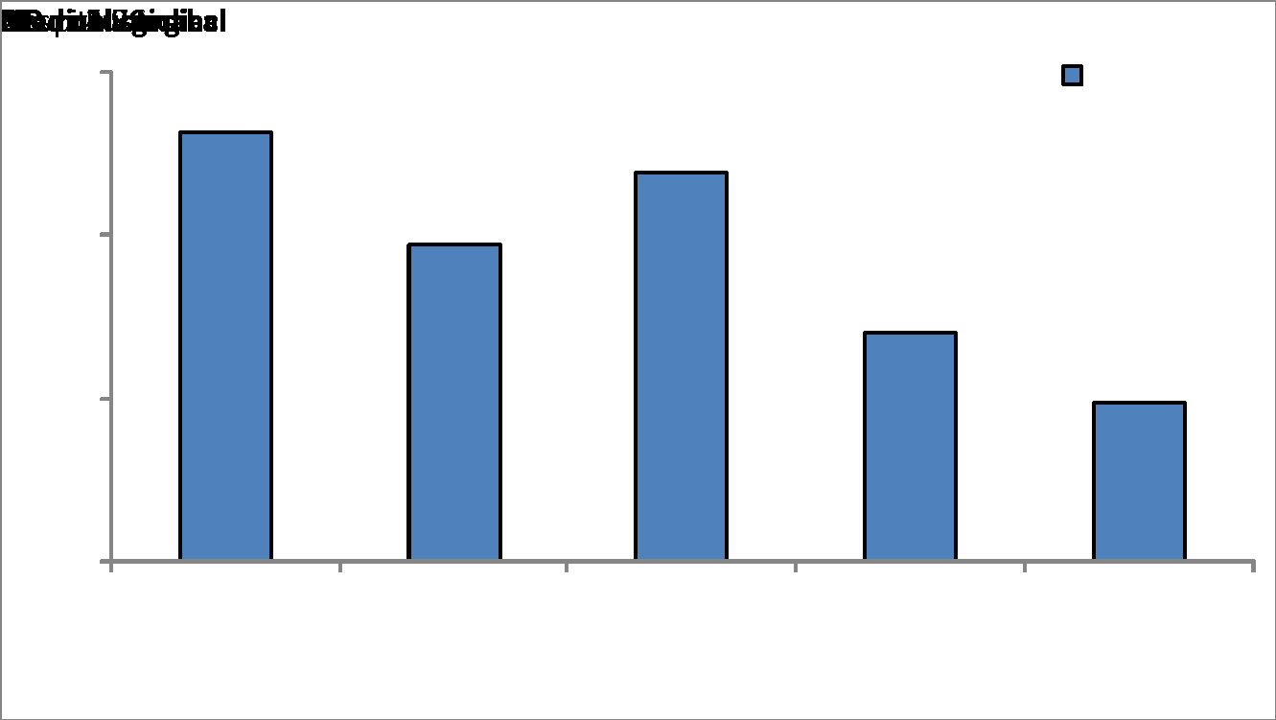
CLABSI SIR-Calculation

Slide 20
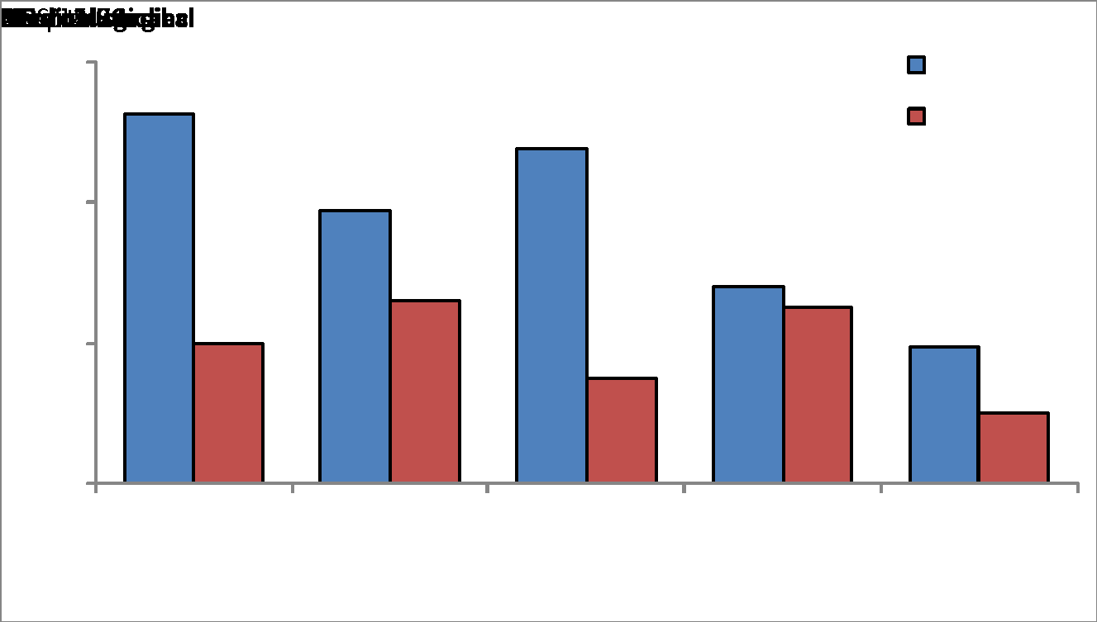
CLABSI SIR-Calculation

Slide 21
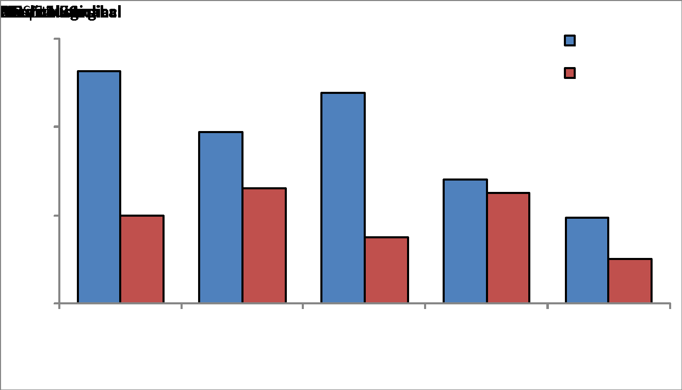
CLABSI SIR-Calculation

Slide 22
CLABSI SIR-Interpretation
Facility name | CLABSI | Central line days | Predicted CLABSI | SIR | SIR p-value | SIR 95% CI
KAMC | 8 | 1,976 | 4.15 | 1.93 | 0.06 | 0.83, 3.80
During 2009, there were 8 CLABSIs identified and 1,976 central line days observed in ICUs of KAMC.
Based on the NHSN 2006-2008 baseline data and the composition of locations in KAMC, 4.15 CLABSIs were predicted.
This results in an SIR of 1.93 (O/P= 8/4.15), signifying that during this time period, KAMC identified 93% more CLABSIs than predicted.
The p-value (0.06) and 95% confidence interval (CI) (0.83, 3.80) indicate that the number of observed CLABSIs is not statistically significantly higher than the number of predicted CLABSIs. (Reminder: If the p-value is less than 0.05 and the 95% CI does not cross 1, the SIR is statistically significantly different than 1.)
Notes:
Building upon this example, we can interpret the SIR with the help of using NHSN reports. NHSN Reports calculates the SIR, the SIR p-value, and the SIR 95% confidence interval for you. With this information, we can show that:
During 2009, there were 8 CLABSIs identified and 1,976 central line days observed in Hospital X’s intensive care units.
Based on the NHSN 2006-2008 baseline data and the composition of locations in Hospital X, 4.15 CLABSIs were predicted.
This results in an SIR of 1.93 (O/P= 8/4.15), signifying that during this time period, this hospital identified 93% more CLABSIs than predicted.
This seems high, doesn’t it? However, the p-value (0.06) and 95% confidence interval (0.83, 3.80) indicate that the number of observed CLABSIs is not statistically significantly higher than the number of predicted CLABSIs. (Reminder: If the p-value is less than 0.05 and the 95% CI does not cross 1, the SIR is statistically significantly different than 1.)

Slide 23
SSI SIR

Slide 24
Indirect Standardization (SSI-CABG)
KAMC JEDDAH |  |  | KAMC RIYADH
Number of surgeries | Number of SSI | Rate | Number of surgeries | Number of SSI | Rate
1154 | 30 | 2.6% | 1154 | 30 | 2.6%
24
Notes:
24
Direct Standardization
Direct standardization is the case were the age specific mortality rates from the index, which is mostly the smaller population in which we are interested, is multiplied with the age structure of a standard.
You can compare the standardized rate with another standardized rate that has been standardized in the same way.
The two rates can be compared directly or the CMF, the ratio of the two rates, can be used.
What are the requirements of direct age adjustment method?
Age–specific mortality rates for the 2 study populations being compared
A standard population which is any population (a real or hypothetical) having a known age composition, selected to be the basis of the comparison
Indirect Standardization
Indirect standardization is the case were the age specific mortality rates from the standard are multiplied with the age structure of the index.
The end result is mostly an expected number of death for the index population which can be compared with the observed number of death using the SMR.
Age specific death rates for the index are not required to do indirect standardization.
What are the requirements of indirect age adjustment method?
Age–specific mortality rates for a standard population
The total number of events (deaths) and age composition of the 2 study populations
SMR
SMR basically compares the mortality observed in the index-population with the mortality that could be expected, if the index-population had an age specific mortality pattern, which is comparable with the age specific mortality of the standard population.
Exact confidence intervals are given when the number of cases is relatively low and approximations are given when the number of cases is larger.
Poisson based confidence intervals are given considering error free expectations, this would be the case if the standard would be a hypothetical mortality schedule.

Slide 25
Indirect Standardization (SSI-CABG)
KAMC JEDDAH |  |  | KAMC RIYADH
Number of surgeries | Number of SSI | Rate | Number of surgeries | Number of SSI | Rate
1154 | 30 | 2.6% | 1154 | 30 | 2.6%
NHSN Published Rates for CABG
Risk index category | Pooled mean
0 | 0.35
1 | 2.55
2 | 4.28
Total | 2.94
25
Notes:
25
Direct Standardization
Direct standardization is the case were the age specific mortality rates from the index, which is mostly the smaller population in which we are interested, is multiplied with the age structure of a standard.
You can compare the standardized rate with another standardized rate that has been standardized in the same way.
The two rates can be compared directly or the CMF, the ratio of the two rates, can be used.
What are the requirements of direct age adjustment method?
Age–specific mortality rates for the 2 study populations being compared
A standard population which is any population (a real or hypothetical) having a known age composition, selected to be the basis of the comparison
Indirect Standardization
Indirect standardization is the case were the age specific mortality rates from the standard are multiplied with the age structure of the index.
The end result is mostly an expected number of death for the index population which can be compared with the observed number of death using the SMR.
Age specific death rates for the index are not required to do indirect standardization.
What are the requirements of indirect age adjustment method?
Age–specific mortality rates for a standard population
The total number of events (deaths) and age composition of the 2 study populations
SMR
SMR basically compares the mortality observed in the index-population with the mortality that could be expected, if the index-population had an age specific mortality pattern, which is comparable with the age specific mortality of the standard population.
Exact confidence intervals are given when the number of cases is relatively low and approximations are given when the number of cases is larger.
Poisson based confidence intervals are given considering error free expectations, this would be the case if the standard would be a hypothetical mortality schedule.

Slide 26
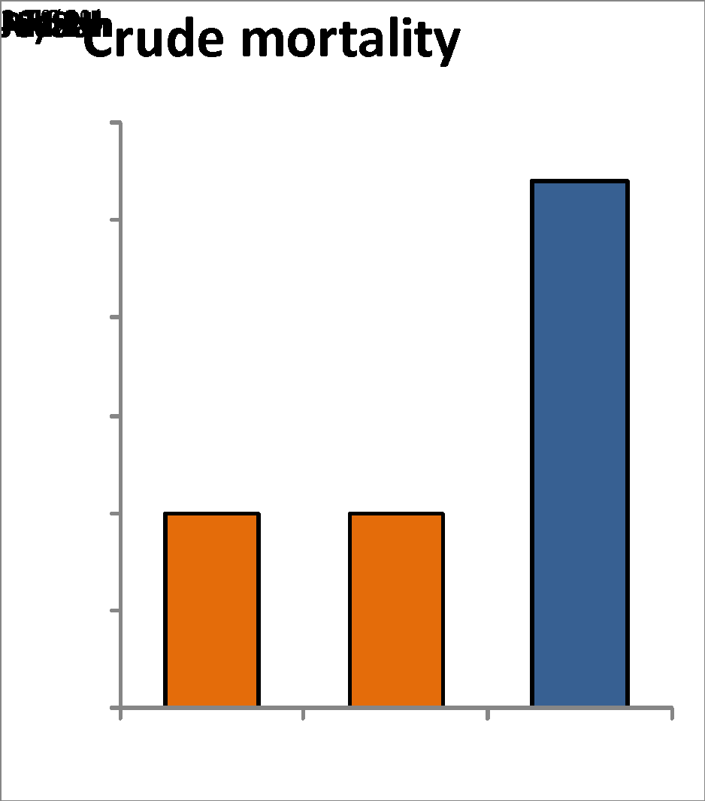
Indirect Standardization (SSI-CABG)
Crude infection rate

Slide 27
Indirect Standardization (SSI-CABG)
Risk index | CABGNHSN rate (R) | KAMC JEDDAH |  |  | KAMC RIYADH
 |  | Number of surgeries (n1) | Observed SSI | Expected SSI (RXn1) | Number of surgeries (n2) | Observed SSI | Expected SSI (RXn2)
0 | 0.35 | 3 |  |  | 500
1 | 2.55 | 950 |  |  | 500
2 | 4.28 | 201 |  |  | 154
Total | 2.94 | 1154 | 30 |  | 1154 | 30
27
Notes:
27
Direct Standardization
Direct standardization is the case were the age specific mortality rates from the index, which is mostly the smaller population in which we are interested, is multiplied with the age structure of a standard.
You can compare the standardized rate with another standardized rate that has been standardized in the same way.
The two rates can be compared directly or the CMF, the ratio of the two rates, can be used.
What are the requirements of direct age adjustment method?
Age–specific mortality rates for the 2 study populations being compared
A standard population which is any population (a real or hypothetical) having a known age composition, selected to be the basis of the comparison
Indirect Standardization
Indirect standardization is the case were the age specific mortality rates from the standard are multiplied with the age structure of the index.
The end result is mostly an expected number of death for the index population which can be compared with the observed number of death using the SMR.
Age specific death rates for the index are not required to do indirect standardization.
What are the requirements of indirect age adjustment method?
Age–specific mortality rates for a standard population
The total number of events (deaths) and age composition of the 2 study populations
SMR
SMR basically compares the mortality observed in the index-population with the mortality that could be expected, if the index-population had an age specific mortality pattern, which is comparable with the age specific mortality of the standard population.
Exact confidence intervals are given when the number of cases is relatively low and approximations are given when the number of cases is larger.
Poisson based confidence intervals are given considering error free expectations, this would be the case if the standard would be a hypothetical mortality schedule.

Slide 28
Indirect Standardization (SSI-CABG)
Risk index | CABGNHSN rate (R) | KAMC JEDDAH |  |  | KAMC RIYADH
 |  | Number of surgeries (n1) | Observed SSI | Expected SSI (RXn1) | Number of surgeries (n2) | Observed SSI | Expected SSI (RXn2)
0 | 0.35 | 3 |  | 0.0 | 500 |  | 1.8
1 | 2.55 | 950 |  | 24.2 | 500 |  | 12.8
2 | 4.28 | 201 |  | 8.6 | 154 |  | 6.6
Total | 2.94 | 1154 | 30 | 32.8 | 1154 | 30 | 21.1
28
Notes:
28
Direct Standardization
Direct standardization is the case were the age specific mortality rates from the index, which is mostly the smaller population in which we are interested, is multiplied with the age structure of a standard.
You can compare the standardized rate with another standardized rate that has been standardized in the same way.
The two rates can be compared directly or the CMF, the ratio of the two rates, can be used.
What are the requirements of direct age adjustment method?
Age–specific mortality rates for the 2 study populations being compared
A standard population which is any population (a real or hypothetical) having a known age composition, selected to be the basis of the comparison
Indirect Standardization
Indirect standardization is the case were the age specific mortality rates from the standard are multiplied with the age structure of the index.
The end result is mostly an expected number of death for the index population which can be compared with the observed number of death using the SMR.
Age specific death rates for the index are not required to do indirect standardization.
What are the requirements of indirect age adjustment method?
Age–specific mortality rates for a standard population
The total number of events (deaths) and age composition of the 2 study populations
SMR
SMR basically compares the mortality observed in the index-population with the mortality that could be expected, if the index-population had an age specific mortality pattern, which is comparable with the age specific mortality of the standard population.
Exact confidence intervals are given when the number of cases is relatively low and approximations are given when the number of cases is larger.
Poisson based confidence intervals are given considering error free expectations, this would be the case if the standard would be a hypothetical mortality schedule.

Slide 29
Indirect Standardization (SSI-CABG)
Risk index | CABGNHSN rate (R) | KAMC JEDDAH |  |  | KAMC RIYADH
 |  | Number of surgeries (n1) | Observed SSI | Expected SSI (RXn1) | Number of surgeries (n2) | Observed SSI | Expected SSI (RXn2)
Total | 2.94 | 1154 | 30 | 32.8 | 1154 | 30 | 21.1
Observed number of SSIs
SIR = × multiplier Expected number of SSIs
KAMC JEDDAH SMR = 30/32.8 = 0.91 = 91 % 9 % less
KAMC RIYADH SMR = 30/21.1 = 1.42 = 142 % 42 % more
29
Notes:
29
Direct Standardization
Direct standardization is the case were the age specific mortality rates from the index, which is mostly the smaller population in which we are interested, is multiplied with the age structure of a standard.
You can compare the standardized rate with another standardized rate that has been standardized in the same way.
The two rates can be compared directly or the CMF, the ratio of the two rates, can be used.
What are the requirements of direct age adjustment method?
Age–specific mortality rates for the 2 study populations being compared
A standard population which is any population (a real or hypothetical) having a known age composition, selected to be the basis of the comparison
Indirect Standardization
Indirect standardization is the case were the age specific mortality rates from the standard are multiplied with the age structure of the index.
The end result is mostly an expected number of death for the index population which can be compared with the observed number of death using the SMR.
Age specific death rates for the index are not required to do indirect standardization.
What are the requirements of indirect age adjustment method?
Age–specific mortality rates for a standard population
The total number of events (deaths) and age composition of the 2 study populations
SMR
SMR basically compares the mortality observed in the index-population with the mortality that could be expected, if the index-population had an age specific mortality pattern, which is comparable with the age specific mortality of the standard population.
Exact confidence intervals are given when the number of cases is relatively low and approximations are given when the number of cases is larger.
Poisson based confidence intervals are given considering error free expectations, this would be the case if the standard would be a hypothetical mortality schedule.

Slide 30
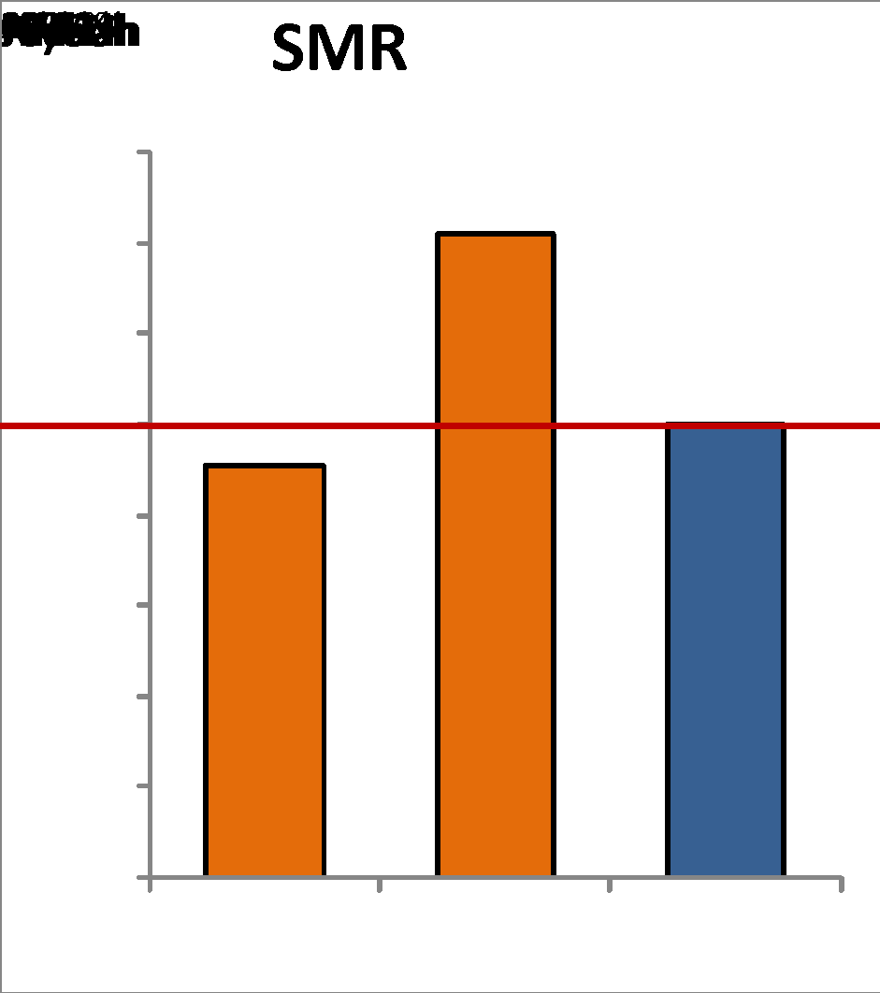
Indirect Standardization (SSI-CABG)
Crude infection rate
Standardized infection rate

Slide 31
MOH CLABSI SIR/SUR

Slide 33
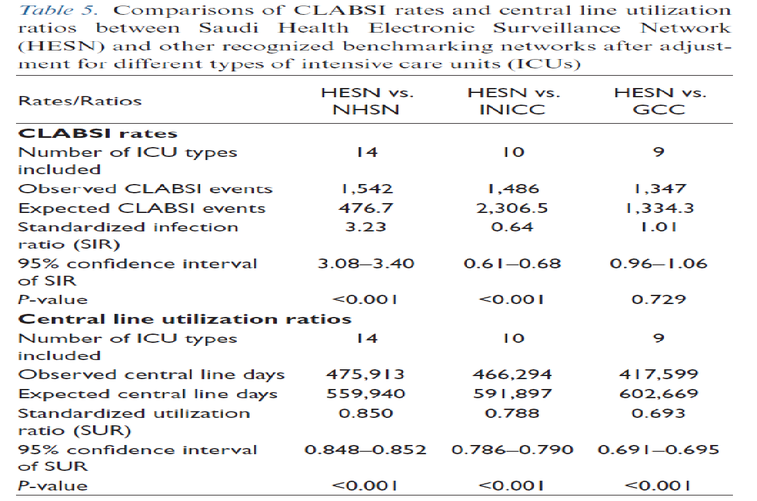

Slide 34
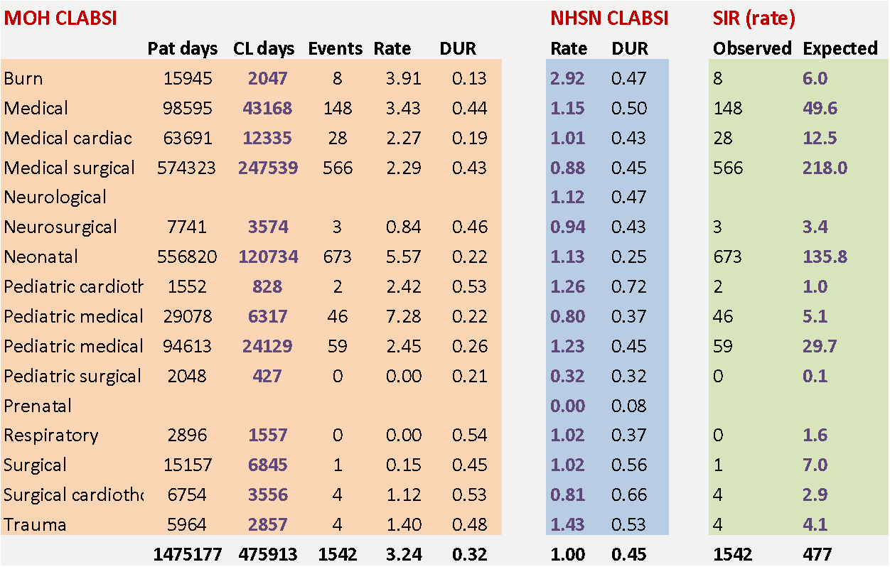
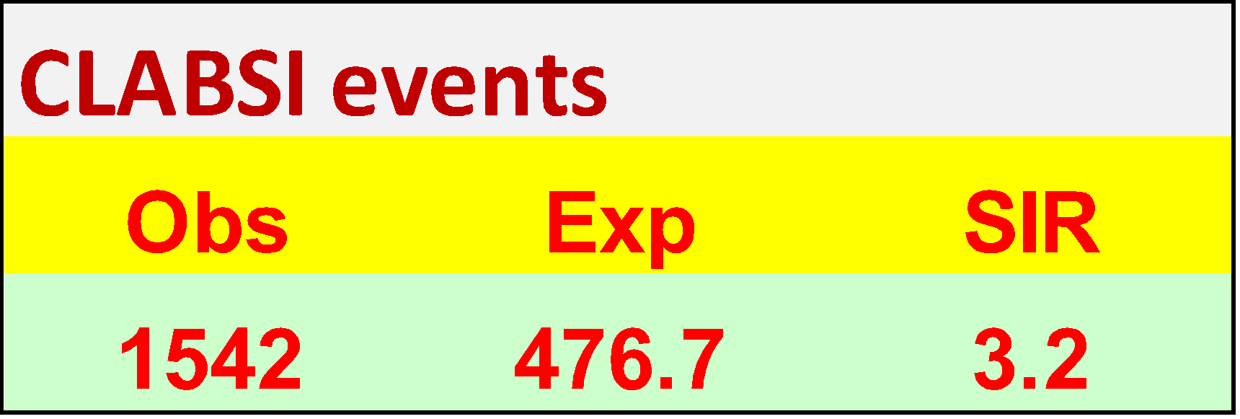
Expected CLABSI events = MOH CL days x NHSN CLABSI rate 1000

Slide 35
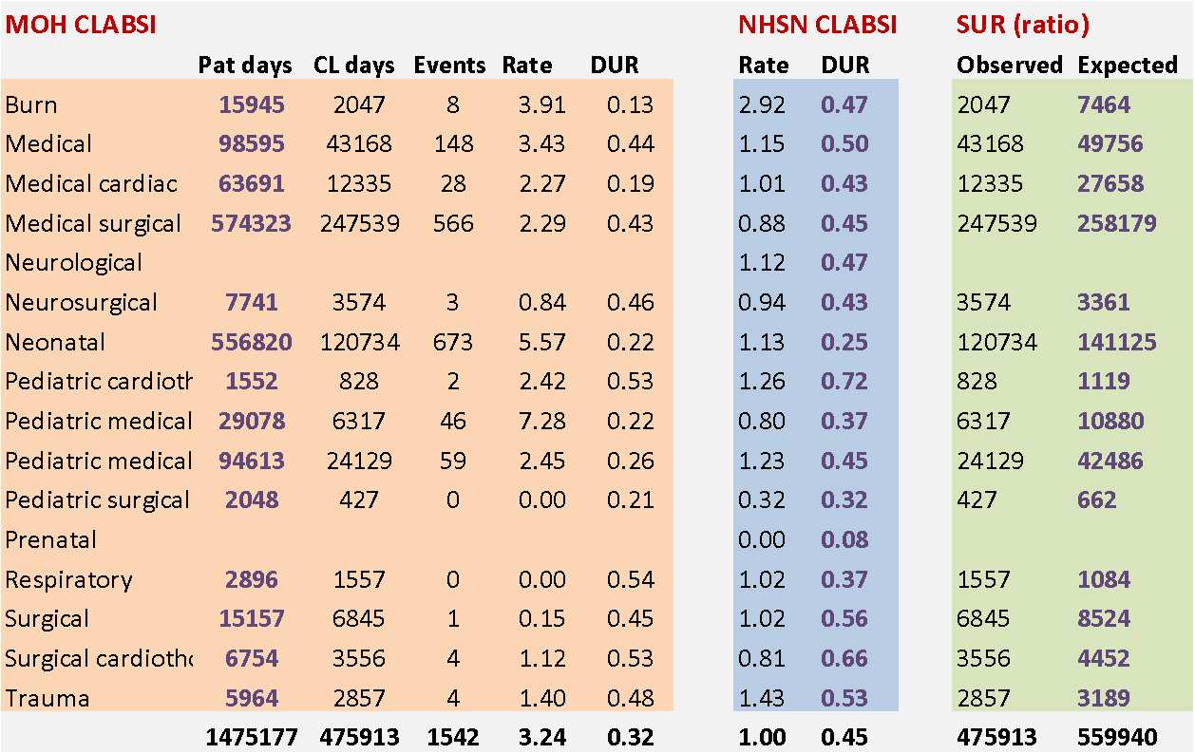
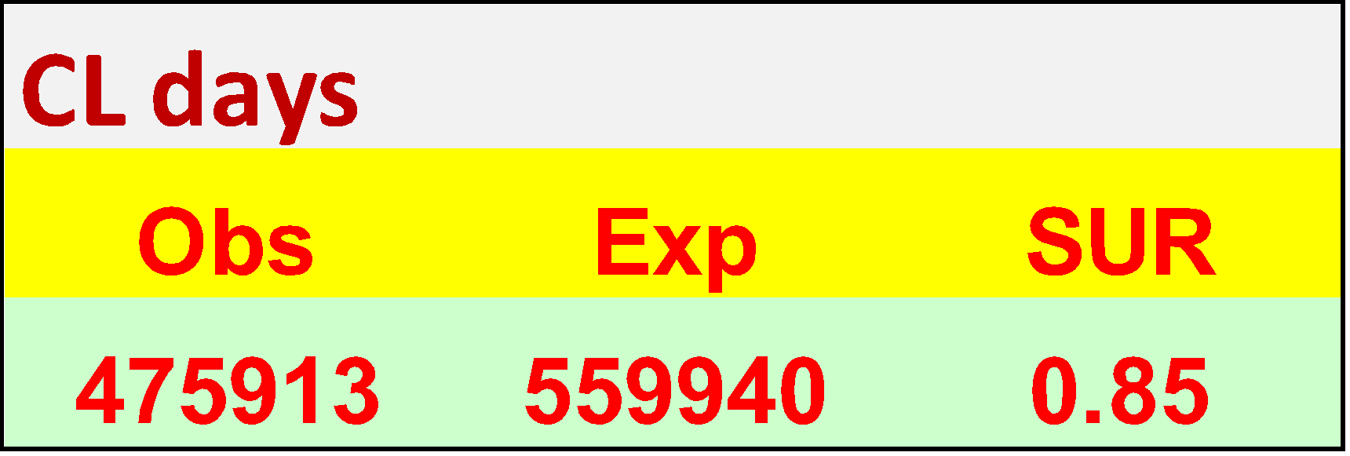
Expected CL days = MOH patient days x NHSN DUR

Slide 36
Multi-adjusted SSI SIR

Slide 37
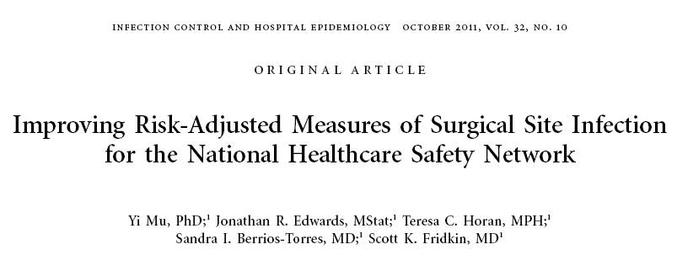
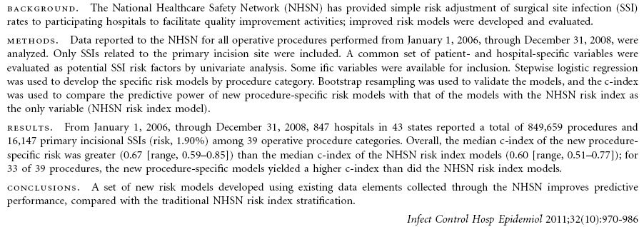
Notes:
The SIR provides improved risk adjustment as compared to the previously used risk index. The risk index relied on 3 risk factors only, and these same risk factors determined the risk for all types of procedures. Also, in the risk index, the relative contribution of each of these factors are constrained to be equal and treated equally in the analysis. The SSI SIR is no longer based on the risk index; therefore, the risk-stratified SSI rates are no longer published.
The SIR, on the other hand, allows specified factors to be considered, allows the set of risk factors to be procedure-specific, and allows each factor’s contribution to vary according to its significant association with risk. To further improve risk adjustment, NHSN is now using logistic regression models for surgical site infection SIR analysis.
Logistic regression is used to determine how one or more independent variables (like gender or ASA score) are related to the probability of the occurrence of one of two possible outcomes (in this case – SSI or no SSI). What this means is that there are mathematical equations that take into account specific risk factors and can generate the predicted number of SSIs for a specific procedure over a certain time period. These models are procedure-specific and allows risk factors to be procedure-specific.

Slide 38
Deriving the SSI SIR Improved risk adjustment
No longer based on the basic risk index
Therefore, recent risk-stratified SSI rates not published
New method uses an improved risk adjustment calculated through logistic regression modeling.
Used for prediction of the probability of occurrence of an event by fitting data
Allows specified risk factors to be considered
Allows risk factors to be procedure-specific
Allows each factor’s contribution to vary according to its association with risk
Notes:
The SIR provides improved risk adjustment as compared to the previously used risk index. The risk index relied on 3 risk factors only, and these same risk factors determined the risk for all types of procedures. Also, in the risk index, the relative contribution of each of these factors are constrained to be equal and treated equally in the analysis. The SSI SIR is no longer based on the risk index; therefore, the risk-stratified SSI rates are no longer published.
The SIR, on the other hand, allows specified factors to be considered, allows the set of risk factors to be procedure-specific, and allows each factor’s contribution to vary according to its significant association with risk. To further improve risk adjustment, NHSN is now using logistic regression models for surgical site infection SIR analysis.
Logistic regression is used to determine how one or more independent variables (like gender or ASA score) are related to the probability of the occurrence of one of two possible outcomes (in this case – SSI or no SSI). What this means is that there are mathematical equations that take into account specific risk factors and can generate the predicted number of SSIs for a specific procedure over a certain time period. These models are procedure-specific and allows risk factors to be procedure-specific.

Slide 39
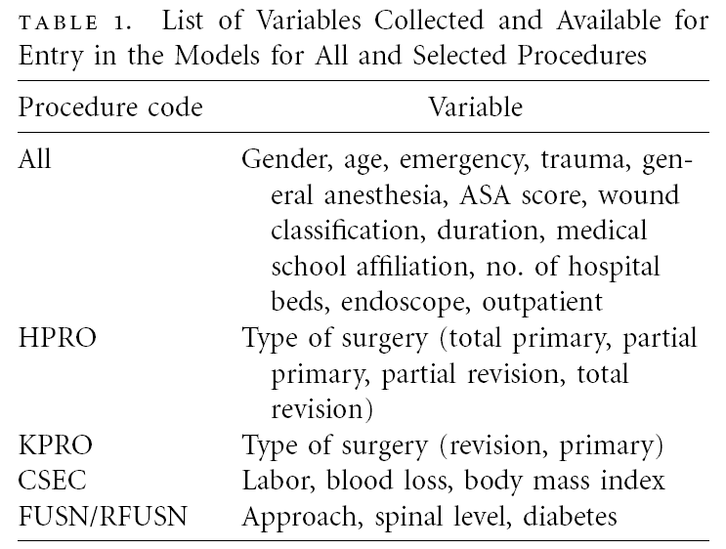
Notes:
The SIR provides improved risk adjustment as compared to the previously used risk index. The risk index relied on 3 risk factors only, and these same risk factors determined the risk for all types of procedures. Also, in the risk index, the relative contribution of each of these factors are constrained to be equal and treated equally in the analysis. The SSI SIR is no longer based on the risk index; therefore, the risk-stratified SSI rates are no longer published.
The SIR, on the other hand, allows specified factors to be considered, allows the set of risk factors to be procedure-specific, and allows each factor’s contribution to vary according to its significant association with risk. To further improve risk adjustment, NHSN is now using logistic regression models for surgical site infection SIR analysis.
Logistic regression is used to determine how one or more independent variables (like gender or ASA score) are related to the probability of the occurrence of one of two possible outcomes (in this case – SSI or no SSI). What this means is that there are mathematical equations that take into account specific risk factors and can generate the predicted number of SSIs for a specific procedure over a certain time period. These models are procedure-specific and allows risk factors to be procedure-specific.

Slide 40
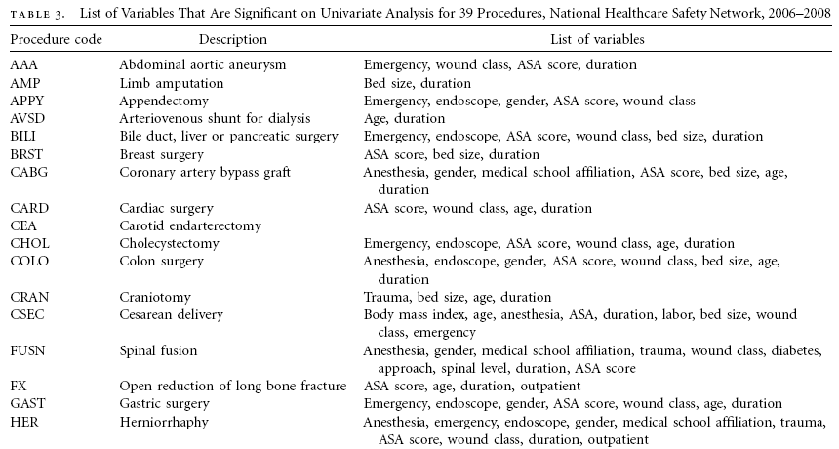
Notes:
The SIR provides improved risk adjustment as compared to the previously used risk index. The risk index relied on 3 risk factors only, and these same risk factors determined the risk for all types of procedures. Also, in the risk index, the relative contribution of each of these factors are constrained to be equal and treated equally in the analysis. The SSI SIR is no longer based on the risk index; therefore, the risk-stratified SSI rates are no longer published.
The SIR, on the other hand, allows specified factors to be considered, allows the set of risk factors to be procedure-specific, and allows each factor’s contribution to vary according to its significant association with risk. To further improve risk adjustment, NHSN is now using logistic regression models for surgical site infection SIR analysis.
Logistic regression is used to determine how one or more independent variables (like gender or ASA score) are related to the probability of the occurrence of one of two possible outcomes (in this case – SSI or no SSI). What this means is that there are mathematical equations that take into account specific risk factors and can generate the predicted number of SSIs for a specific procedure over a certain time period. These models are procedure-specific and allows risk factors to be procedure-specific.

Slide 41
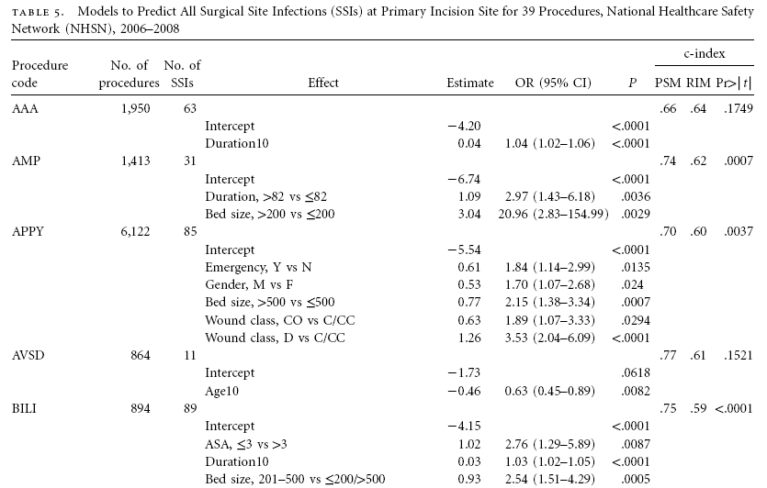
Notes:
The SIR provides improved risk adjustment as compared to the previously used risk index. The risk index relied on 3 risk factors only, and these same risk factors determined the risk for all types of procedures. Also, in the risk index, the relative contribution of each of these factors are constrained to be equal and treated equally in the analysis. The SSI SIR is no longer based on the risk index; therefore, the risk-stratified SSI rates are no longer published.
The SIR, on the other hand, allows specified factors to be considered, allows the set of risk factors to be procedure-specific, and allows each factor’s contribution to vary according to its significant association with risk. To further improve risk adjustment, NHSN is now using logistic regression models for surgical site infection SIR analysis.
Logistic regression is used to determine how one or more independent variables (like gender or ASA score) are related to the probability of the occurrence of one of two possible outcomes (in this case – SSI or no SSI). What this means is that there are mathematical equations that take into account specific risk factors and can generate the predicted number of SSIs for a specific procedure over a certain time period. These models are procedure-specific and allows risk factors to be procedure-specific.

Slide 42
Using logistic regression model to calculate SSI risk for 1 hypothetical patient
Risk Factor* (X1-X4) | Parameter Estimate (β1 –β4) | Odds Ratio | p-value
Intercept | -5.448 | --- | ---
Age (≤44* vs >44) | 0.520 | 1.659 | <0.001
ASA (3/4/5* vs 1/2) | 0.425 | 1.529 | 0.041
Duration (>100 mins* vs ≤100 mins) | 0.501 | 1.650 | 0.002
Med school affiliation (Y*/N) | 1.069 | 2.912 | <0.001
Hypothetical patient: 40 years old, ASA score of 4, duration of 117 minutes, medical school affiliated
logit (p) = α + β1X1 + β2X2 + β3X3 + β4X4
logit (p) = -5.448 + 0.520(1*) + 0.425(1*) + 0.501(1*) + 1.069(1*)
= 0.05 (individual patient’s risk)
*For these risk factors, if present = 1; if not = 0
Notes:
This model was developed by NHSN for teaching purposes to show how a SSI SIR is derived – this example should not be used to calculate a patient’s risk of SSI in your facility.
This table lists some of the risk factors found to be significant for NHSN operative procedure categories. For the purposes of this webinar, let’s assume these are all of the significant SSI risk factors for the type of procedure this patient had. Note that each risk factor’s contribution varies, as represented by the parameter estimate (β) for each factor. These parameter estimates can be plugged into the formula above for each β, and either a 0 or 1 will be plugged into each x. For the risk factors with an asterisk, if present for that patient, x=1, if not x=0.
In this example with hypothetical patient #1 who is 40 years old, has an ASA score of 4, the operation duration was 117 minutes, and the hospital is medical school affiliated, we can see that each risk factor is considered present, and 1 should replace each x in the equation. Once each x is plugged in, the equation can be calculated. For this patient, the probability of an SSI using this logistic regression model is 0.05, which can be interpreted as a 5% risk of infection for patient #1.

Slide 43
SSI SIR incorporating many patients
Patient | Age | ASA score | Duration | Medical school affiliation | SSI observed | Probability of SSI
1 | 40 | 4 | 117 | Y | 0 | 0.050
2 | 53 | 2 | 95 | N | 0 | 0.004
3 | 30 | 2 | 107 | Y | 1 | 0.033
. | . | . | . | . | . | .
100 | 37 | 4 | 128 | Y | 1 | 0.050
Total | --- | --- | --- | --- | 3 | 2.91
SIR = number of observed SSIs = 3 = 1.03
number of predicted SSIs 2.91
* Does not include all risk factors for SSIs
Notes:
The probability is calculated for each patient and then summed to give the predicted number of SSIs for this population. This table represents a partial list of 100 hypothetical patients who have undergone this particular procedure and the significant risk factors present for each.
There were 3 SSIs observed for this particular procedure for the identified period of time. 2.91 SSIs were predicted by using this logistic regression model. To calculate the SIR, you divide 3 (observed) by 2.91 (predicted), for an SIR of 1.03.

Slide 44
Thanks !

